Slide 1
IT1020 – Introduction to computer systems
Lecture 5: Logic circuits and simplification

Slide 2
Lecture content
Logic Gates and Circuits
Simplification of Digital Circuits
K-Map Simplification Rules
K- Map Simplification Guide

Slide 3
Semiconductors to Computers
Increasing level of complexity:
Transistors built from semiconductors
Logic gates built from transistors
Logic functions built from gates
Flip-flops built from logic gates
Counters and sequencers from flip-flops Microprocessors from sequencers
Computers from microprocessors

Slide 4
Logic Gates
Logic Gates are the building blocks of Digital Circuits
Logic Gate is an electronic circuit having one or more than one input and only one output
The relationship between the input and the output is based on a certain logic
Inputs and Outputs can be represented as binary variables (logic variables, Boolean variables)

Slide 5
Logic Gates
Used algebraic or tabular forms to describe the manipulation and processing of binary information.
Important advantages for two-valued Digital Circuit:
Mathematical Model – Boolean Algebra
Can help design, analyse, simplify Digital Circuits.

Slide 6
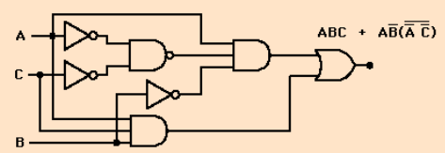
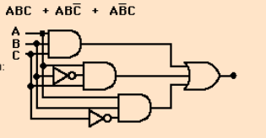
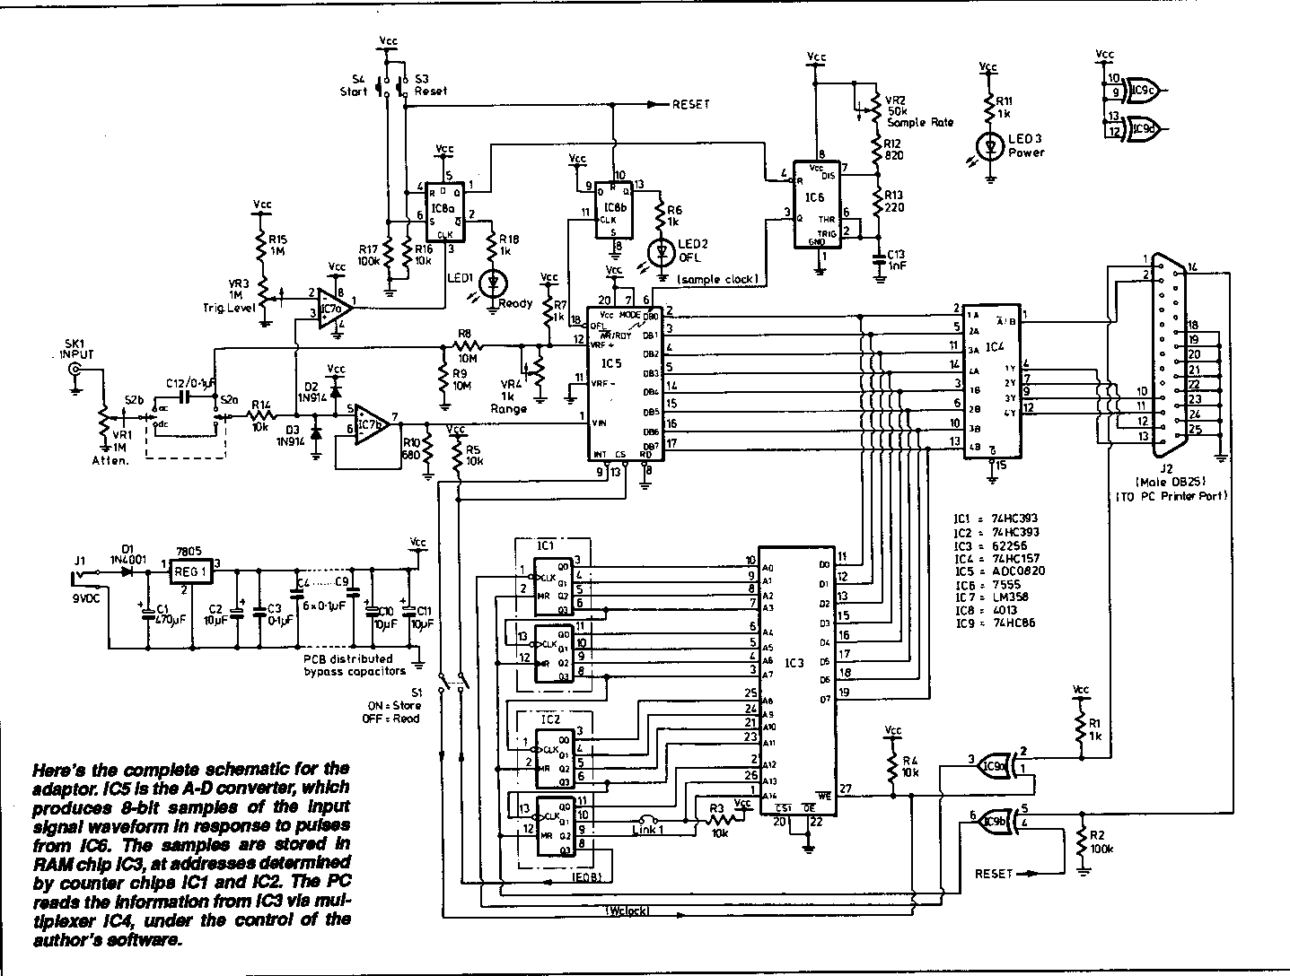
Digital Logic Circuits

Slide 7


Simplified Digital Logic Circuits

Slide 8
Simplification of the Digital Logic Circuits
Why do we need simplification?
To reduce the number of gates required to build the circuit and hence:
Reduce the cost
Reduce the power consumption
Reduce the space required
Reduce the propagation delay

Slide 9
Simplification of the Digital Logic Circuits
Methods to Simplify the Digital Logic Circuits
Using Truth Table
Using Mathematical Method
Using Truth Table
The problem is analyzed
The truth table is developed
Using the truth table the circuit is built.

Slide 10
Simplification of Combinational Circuits Using Mathematical Methods
There are two methods to simplify the combinational Circuits
Boolean Algebraic method
K-map

Slide 11
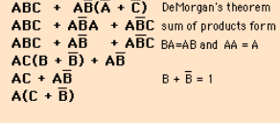
Simplification of Combinational Circuits

Slide 12

Simplification of Combinational Circuits

Slide 13
Karnaugh map - K-Map
The Karnaugh map was invented in 1952 by Edward W. Veitch.
It was further developed in 1953 by Maurice Karnaugh, a physicist at Bell Labs, to help simplify digital electronic circuits.
While exploring the new field of digital logic and its application to the design of telephone circuits, he invented a graphical way of visualizing and then simplifying Boolean expressions.
This graphical representation, now known as a Karnaugh map, or Kmap, is named in his honor.

Slide 14
Description of K-maps and Terminology
A Kmap is a matrix consisting of rows and columns that represent the output values of a Boolean function.
The output values placed in each cell are derived from the minterms of a Boolean function.
A minterm is a product term that contains all of the function’s variables exactly once, either complemented or not complemented.

Slide 15

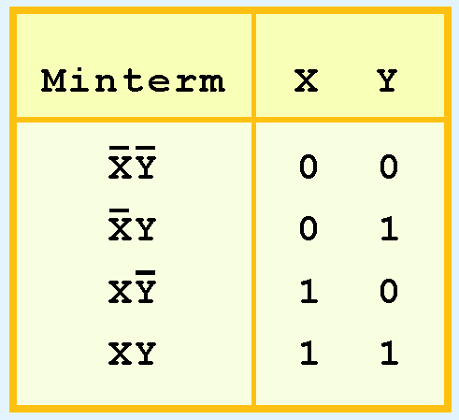
Description of K-maps and Terminology
For example, the minterms for a function having the inputs x and y are:
Consider the Boolean function,
Its minterms are:
A two-variable function, such as f(x,y), has 2²= 4 minterms:

Slide 16
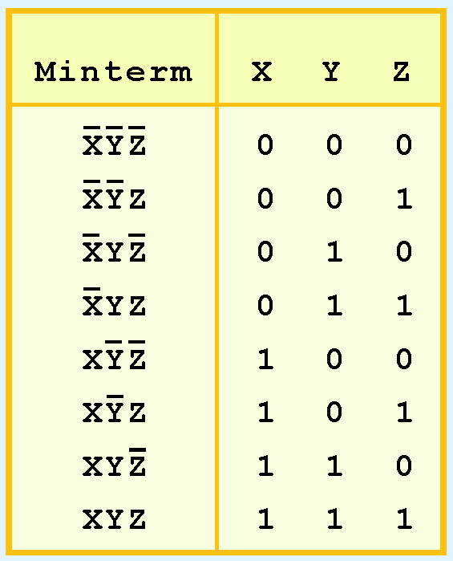
Description of K-maps and Terminology
Similarly, a function having three inputs, has the minterms that are shown in this diagram.
2³ =8 miniterms

Slide 17
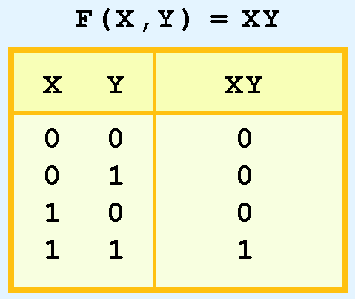
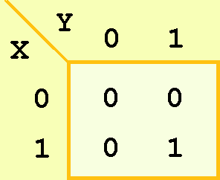
Description of K-maps and Terminology
A Kmap has a cell for each minterm.
This means that it has a cell for each line for the truth table of a function.
The truth table for the function F(x,y) = xy is shown at the right along with its corresponding Kmap.

Slide 18
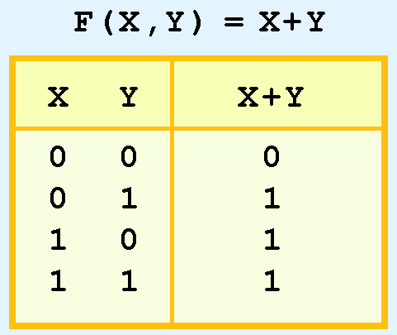
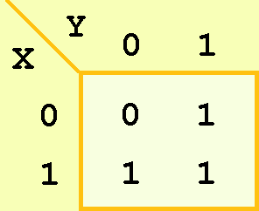

Description of K-maps and Terminology
As another example, we give the truth table and KMap for the function, F(x,y) = x + y at the right.
This function is equivalent to the OR of all of the minterms that have a value of 1. Thus:

Slide 19
K-map Simplification for Two Variables
Of course, the minterm function that we derived from our Kmap was not in simplest terms.
That’s what we started with in this example.
We can, however, reduce our complicated expression to its simplest terms by finding adjacent 1s in the Kmap that can be collected into groups that are powers of two.
In our example, we have two such groups.
Can you find them?

Slide 20
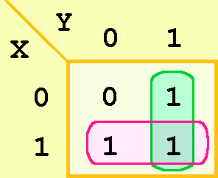
K-map Simplification for Two Variables
The best way of selecting two groups of 1s form our simple Kmap is shown below.
We see that both groups are powers of two and that the groups overlap.

Slide 21
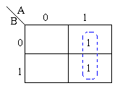
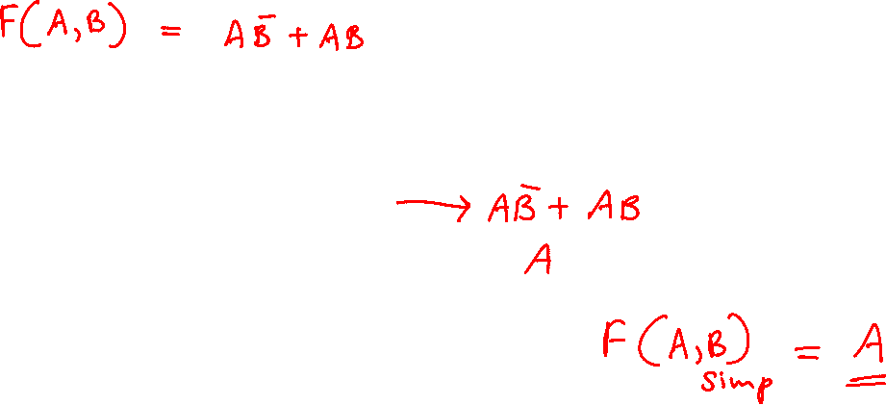
Example -1
Consider the following map.
The function plotted is:
Z = f(A,B) = AB + AB
Using algebraic simplification,
Z = AB + AB
Z = A(B+ B)
Z = A
B becomes redundant
Referring to the map, the two adjacent 1's are grouped together. Through inspection it can be seen that variable B has its true and false form within the group. This eliminates variable B leaving only variable A which only has its true form.
The minimized answer therefore is Z = A.

Slide 22
K-map Simplification for Two Variables
The rules of K-map simplification are:
Groupings can contain only 1s; no 0s.
Groups can be formed only at right angles; diagonal groups are not allowed.
The number of 1s in a group must be a power of 2 – even if it contains a single 1.
The groups must be made as large as possible.
Groups can overlap and wrap around the sides of the Kmap.

Slide 23
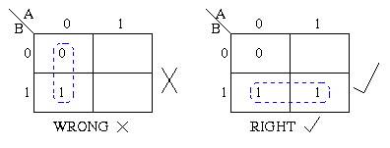
K-Maps – Rules
Group only elements containing 1

Slide 24
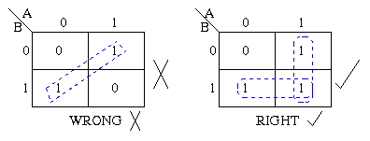
K-Maps – Rules
Only Horizontal and Vertical Grouping
Diagonal not allowed

Slide 25
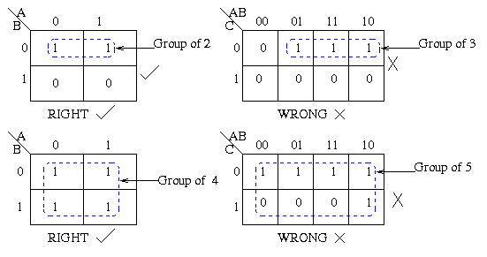
K-Maps – Rules
Groups Powers of 2

Slide 26
K-Maps – Rules
Groups Power of 2

Slide 27
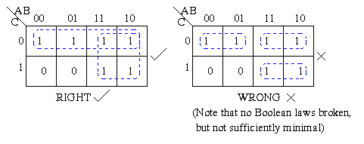
K-Maps – Rules
Each group should be large as possible

Slide 28
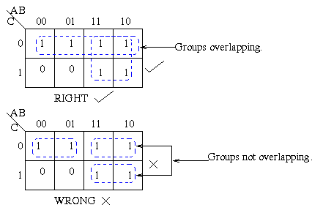
K-Maps – Rules
Groups may overlap

Slide 29
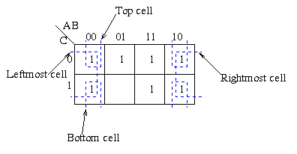
K-Maps – Rules
Groups may wrap around the table

Slide 30
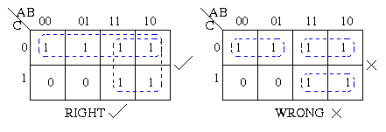
K-Maps – Rules
Should have few groups as possible

Slide 31
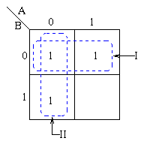
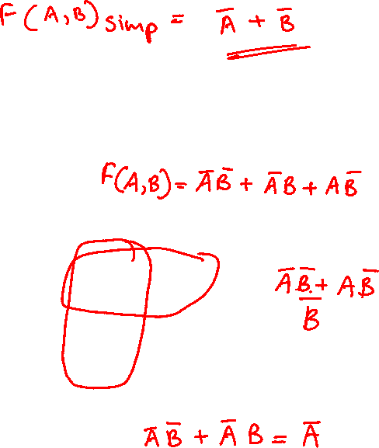
Example-2
Pairs of 1's are grouped as shown above, and the simplified answer is obtained by using the following steps:
Note that two groups can be formed for the example given above, bearing in mind that the largest rectangular clusters that can be made consist of two 1s.
Notice that a 1 can belong to more than one group.
The first group labelled I, consists of two 1s which correspond to A = 0, B = 0 and A = 1, B = 0.
Put in another way, all squares in this example that correspond to the area of the map where B = 0 contains 1s, independent of the value of A.
So when B = 0 the output is 1.
The expression of the output will contain the term B
For group labeled II corresponds to the area of the map where A = 0.
The group can therefore be defined as A
This implies that when A = 0 the output is 1.
The output is therefore 1 whenever B = 0 and A = 0
Hence the simplified answer is Z = A + B
Consider the following map.
The function plotted is:
Z = f(A,B) =AB + AB + AB

Slide 32
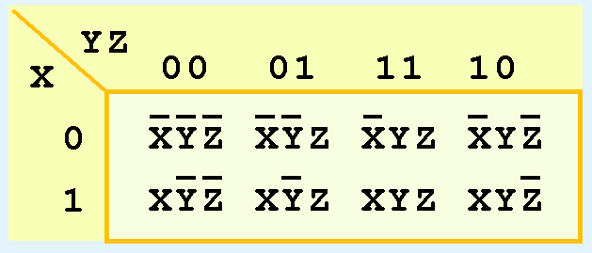
K-map Simplification for Three Variables
A Kmap for three variables is constructed as shown in the diagram below.
We have placed each minterm in the cell that will hold its value.
Notice that the values for the yz combination at the top of the matrix form a pattern that is not a normal binary sequence.

Slide 33
K-map Simplification for Three Variables
Thus, the first row of the Kmap contains all minterms where x has a value of zero.
The first column contains all minterms where y and z both have a value of zero.

Slide 34
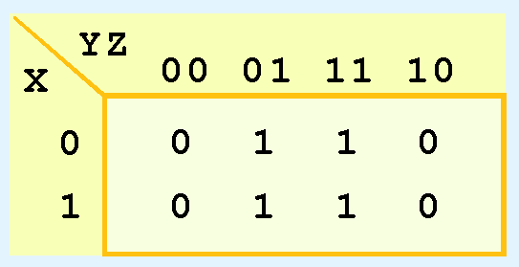
K-map Simplification for Three Variables
Consider the function:
Its Kmap is given below.
What is the largest group of 1s that is a power of 2?

Slide 35
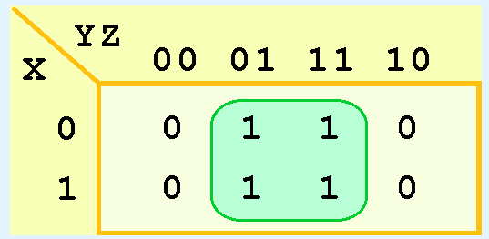
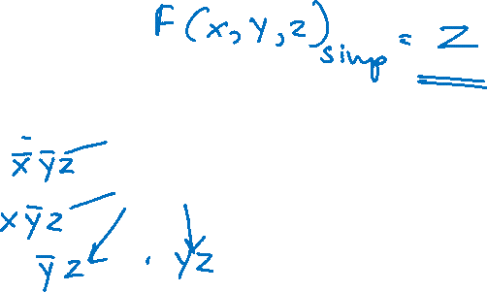
K-map Simplification for Three Variables
This grouping tells us that changes in the variables x and y have no influence upon the value of the function: They are irrelevant.
This means that the function,
reduces to F(x) = z.
You could verify this reduction with identities or a truth table.

Slide 36
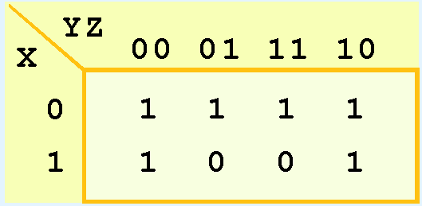
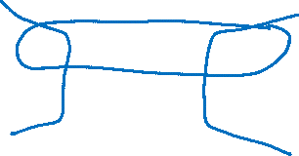
K-map Simplification for Three Variables
Now for a more complicated Kmap. Consider the function:
Its Kmap is shown below. There are (only) two groupings of 1s.
Can you find them?

Slide 37
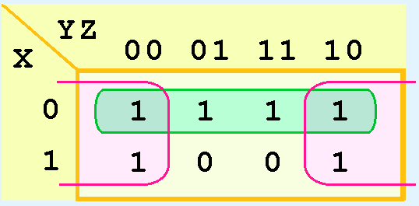
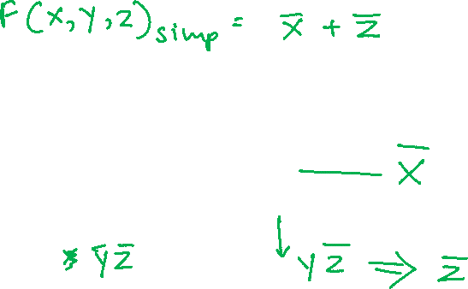
K-map Simplification for Three Variables
In this Kmap, we see an example of a group that wraps around the sides of a Kmap.
This group tells us that the values of x and y are not relevant to the term of the function that is encompassed by the group.
What does this tell us about this term of the function?
What about the green group in the top row?

Slide 38
K-map Simplification for Three Variables
The green group in the top row tells us that only the value of x is significant in that group.
We see that it is complemented in that row, so the other term of the reduced function is .
Our reduced function is: F(x,y,z) = X + Z
Recall that we had six minterms in our original function!

Slide 39
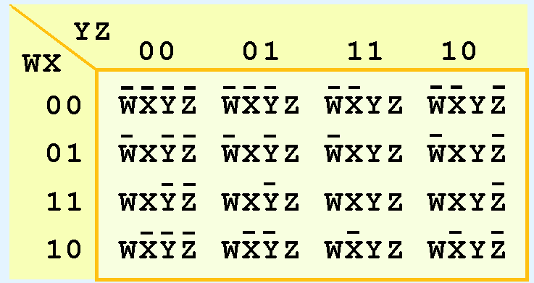
K-map Simplification for Four Variables
Our model can be extended to accommodate the 16 minterms that are produced by a four-input function.
This is the format for a 16-minterm Kmap.

Slide 40
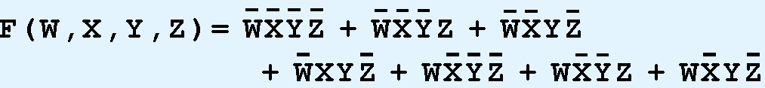
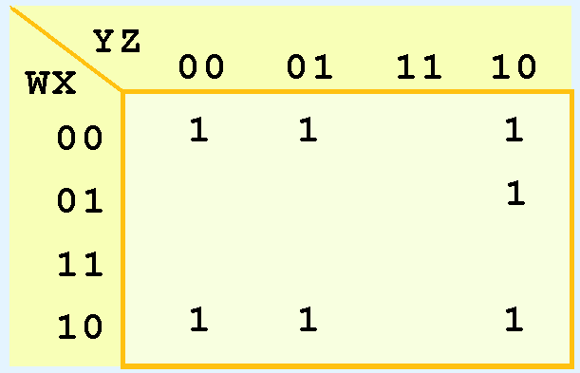
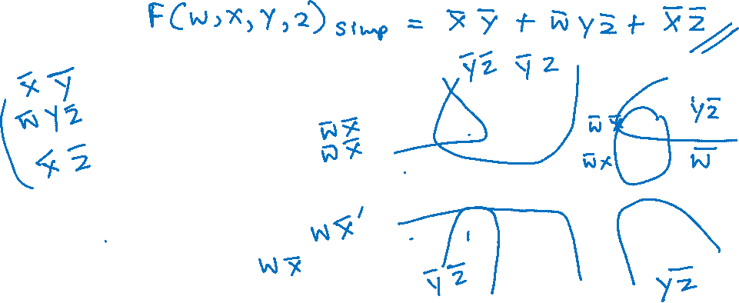
K-map Simplification for Four Variables
We have populated the Kmap shown below with the nonzero minterms from the function:
Can you identify (only) three groups in this Kmap?
Recall that groups can overlap.

Slide 41
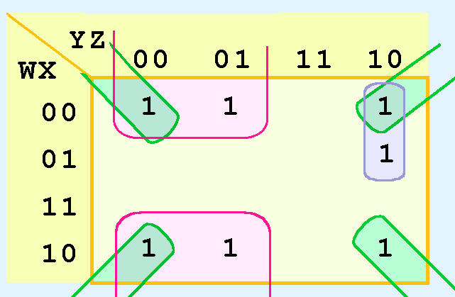
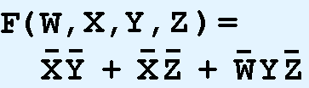
K-map Simplification for Four Variables
Our three groups consist of:
A purple group entirely within the Kmap at the right.
A pink group that wraps the top and bottom.
A green group that spans the corners.
Thus we have three terms in our final function:

Slide 42
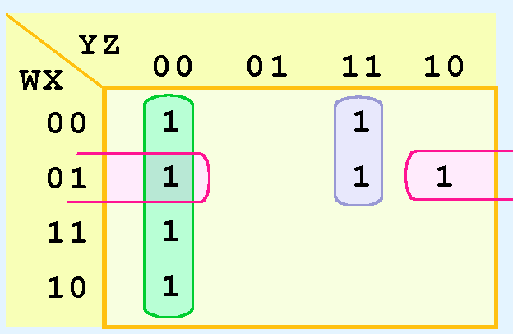
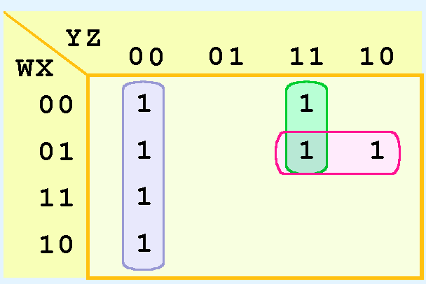
K-map Simplification for Four Variables
It is possible to have a choice as to how to pick groups within a Kmap, while keeping the groups as large as possible.
The (different) functions that result from the groupings below are logically equivalent.

Slide 43
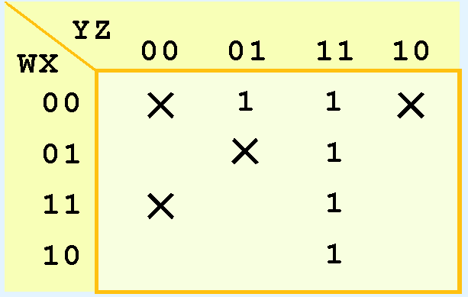
Don’t Care Conditions
In a Kmap, a don’t care condition is identified by an X in the cell of the minterm(s) for the don’t care inputs, as shown below.
In performing the simplification, we are free to include or ignore the X’s when creating our groups.

Slide 44

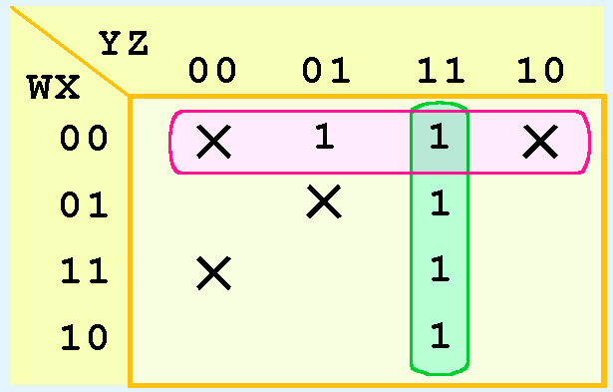
Don’t Care Conditions
In one grouping in the Kmap below, we have the function:

Slide 45

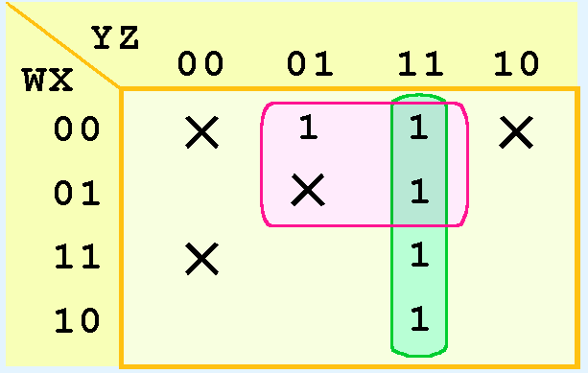
Don’t Care Conditions
A different grouping gives us the function:

Slide 46
Don’t Care Conditions
The truth table of:
is different from the truth table of:
However, the values for which they differ, are the inputs for which we have don’t care conditions.

Slide 47
THANK YOU

